Slide 1

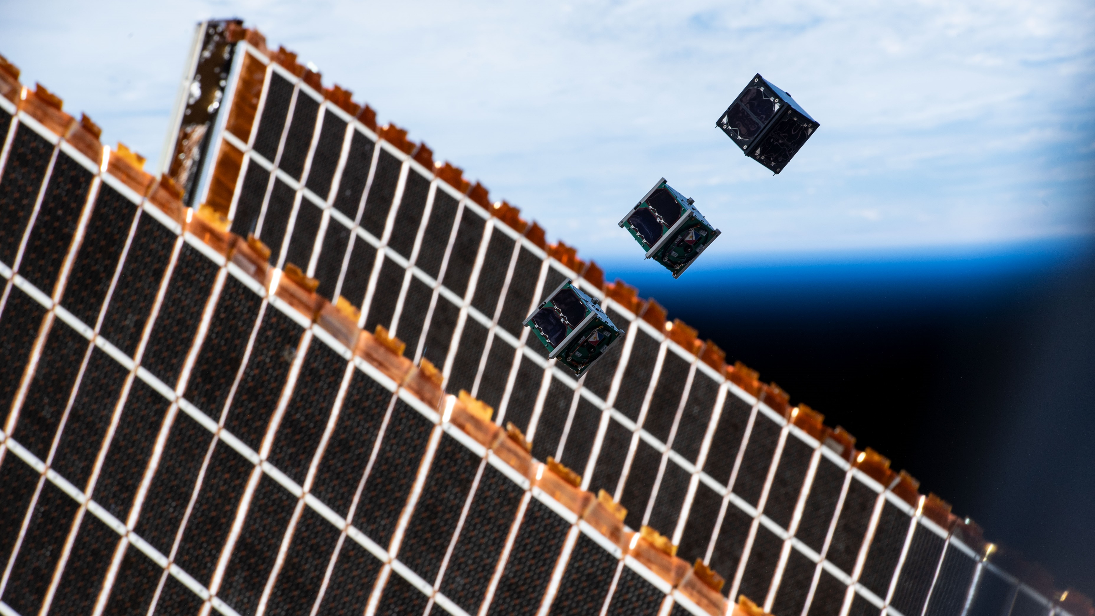



SCHOOL HOLIDAY
PROGRAM SUMMER 2024

Slide 2
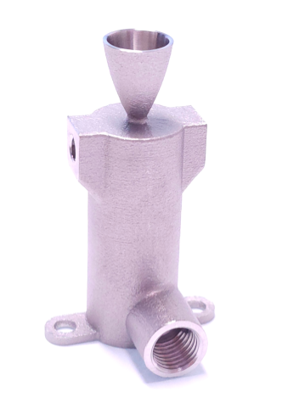
My journey started with what you are all doing, building and launching model rockets.
That passion has turned into my job, doing propulsion engineering at the Binar Space Program.
What I do now? Design and testing of tiny rocket engines for small spacecraft.
Notes:
What is BinarX?
The BinarX Outreach Program is a high school outreach program that empowers WA students to design and build payloads for low-Earth orbit on board Binar CubeSats
We have grown from 3 groups (encompassing 5 schools) to 11 groups (encompassing 13 schools), but will cap participation at 8 schools or groups as we have more demand for the program than we can currently service.
We will also be running the school holiday program building payloads on Rob Howie’s custom PCBs and launching them in rockets that the students build and customise with 3D printed nose cones, which currently has 11 confirmed enrollments with students from 6 different schools or school groups across WA. 2 of these schools are not yet participating in the BinarX 2024 program so we expect the interest for participation to continue to grow.

Slide 3
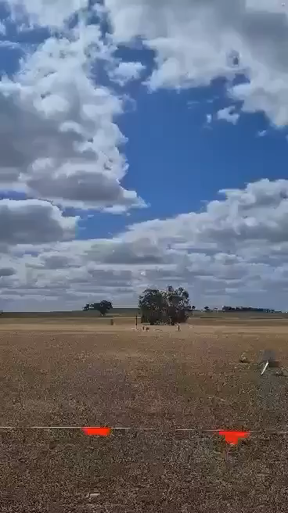
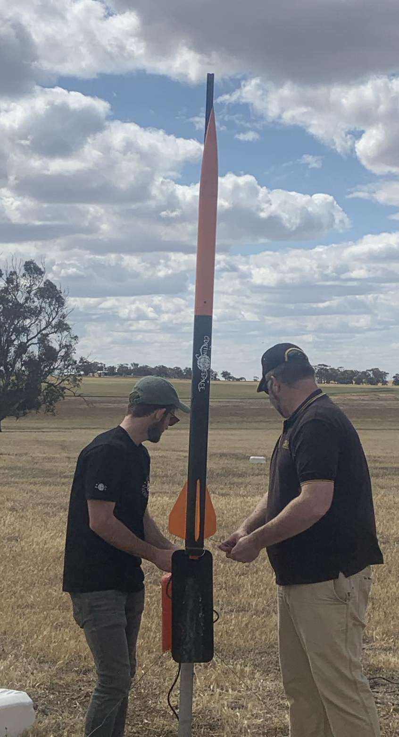
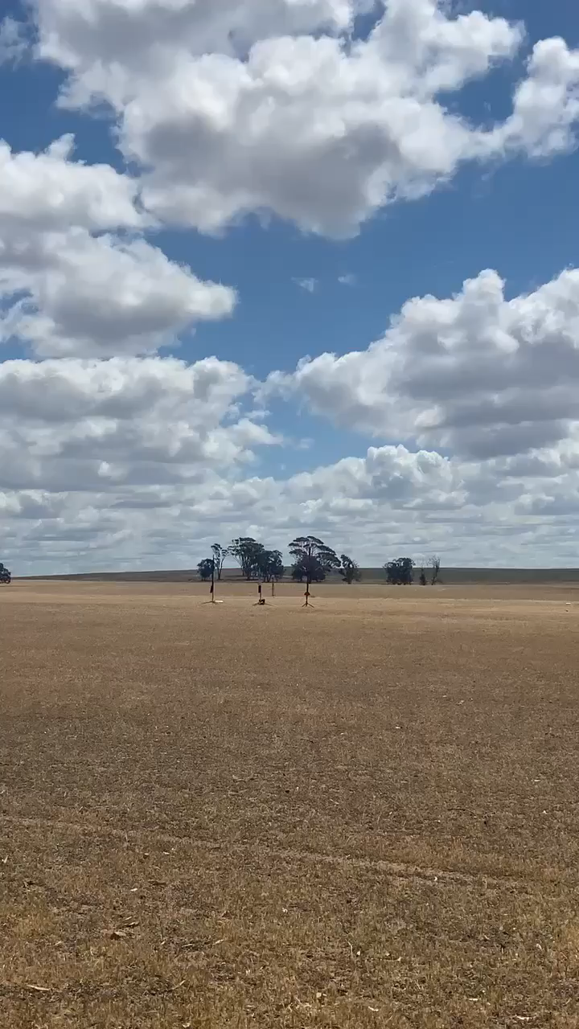
Notes:
What is BinarX?
The BinarX Outreach Program is a high school outreach program that empowers WA students to design and build payloads for low-Earth orbit on board Binar CubeSats
We have grown from 3 groups (encompassing 5 schools) to 11 groups (encompassing 13 schools), but will cap participation at 8 schools or groups as we have more demand for the program than we can currently service.
We will also be running the school holiday program building payloads on Rob Howie’s custom PCBs and launching them in rockets that the students build and customise with 3D printed nose cones, which currently has 11 confirmed enrollments with students from 6 different schools or school groups across WA. 2 of these schools are not yet participating in the BinarX 2024 program so we expect the interest for participation to continue to grow.

Slide 4
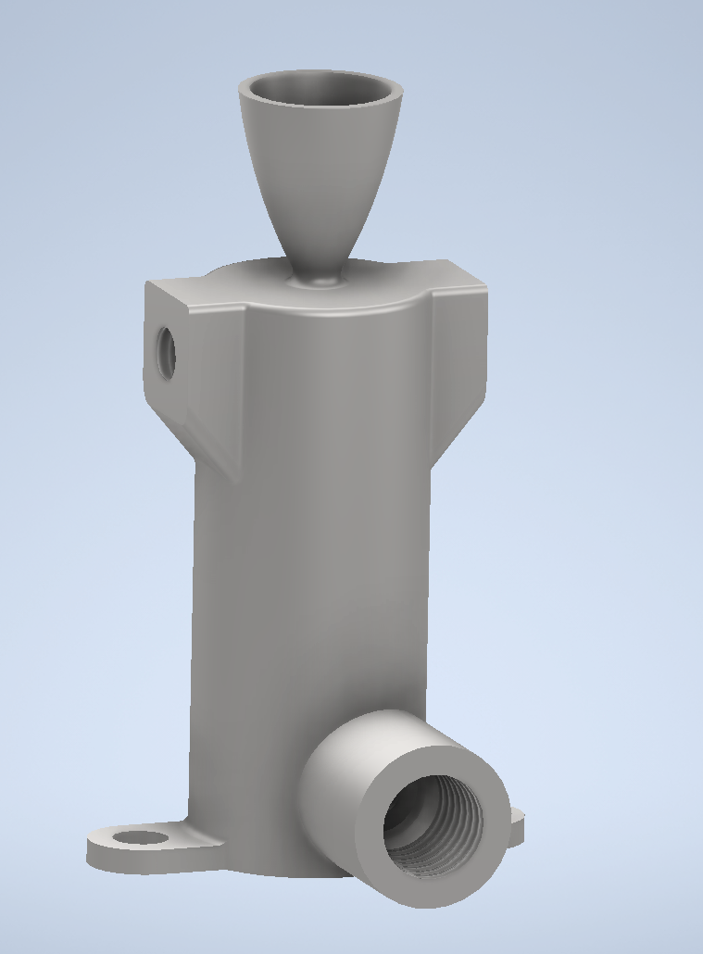
3D Printing / Additive Manufacturing
Turn digital models from the computer into real parts
STL
Notes:
What is BinarX?
The BinarX Outreach Program is a high school outreach program that empowers WA students to design and build payloads for low-Earth orbit on board Binar CubeSats
We have grown from 3 groups (encompassing 5 schools) to 11 groups (encompassing 13 schools), but will cap participation at 8 schools or groups as we have more demand for the program than we can currently service.
We will also be running the school holiday program building payloads on Rob Howie’s custom PCBs and launching them in rockets that the students build and customise with 3D printed nose cones, which currently has 11 confirmed enrollments with students from 6 different schools or school groups across WA. 2 of these schools are not yet participating in the BinarX 2024 program so we expect the interest for participation to continue to grow.

Slide 5
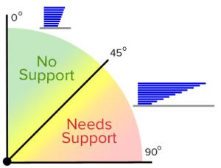
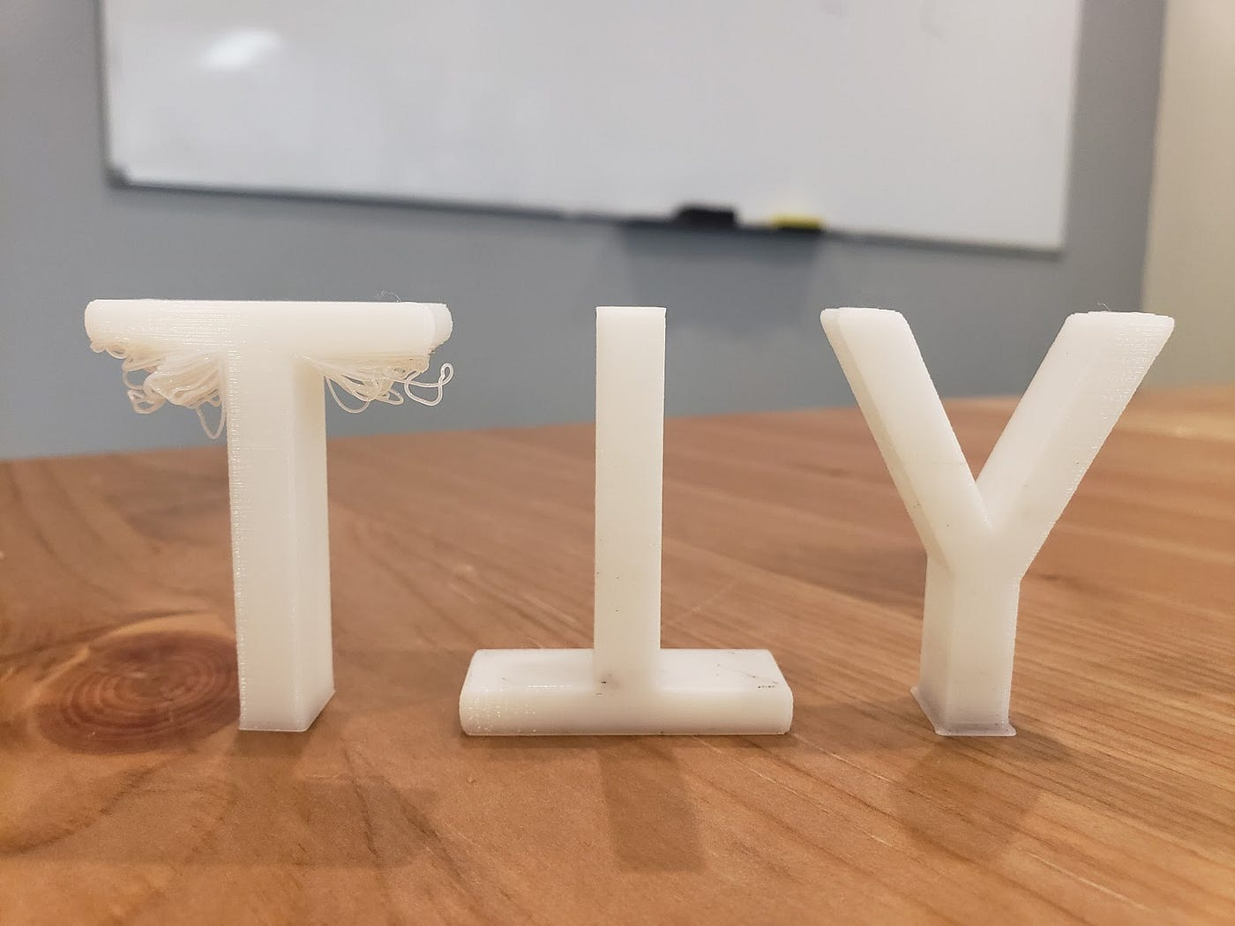
Important Considerations for 3D Printing
Material ------- Print orientation and overhang ------- Supports
Ref: https://www.simplify3d.com/how-to-use-supports/
Notes:
What is BinarX?
The BinarX Outreach Program is a high school outreach program that empowers WA students to design and build payloads for low-Earth orbit on board Binar CubeSats
We have grown from 3 groups (encompassing 5 schools) to 11 groups (encompassing 13 schools), but will cap participation at 8 schools or groups as we have more demand for the program than we can currently service.
We will also be running the school holiday program building payloads on Rob Howie’s custom PCBs and launching them in rockets that the students build and customise with 3D printed nose cones, which currently has 11 confirmed enrollments with students from 6 different schools or school groups across WA. 2 of these schools are not yet participating in the BinarX 2024 program so we expect the interest for participation to continue to grow.

Slide 6
Important Considerations for 3D Printing
Material ------- Print orientation and overhang ------- Supports
Ref: https://www.simplify3d.com/how-to-use-supports/
Notes:
What is BinarX?
The BinarX Outreach Program is a high school outreach program that empowers WA students to design and build payloads for low-Earth orbit on board Binar CubeSats
We have grown from 3 groups (encompassing 5 schools) to 11 groups (encompassing 13 schools), but will cap participation at 8 schools or groups as we have more demand for the program than we can currently service.
We will also be running the school holiday program building payloads on Rob Howie’s custom PCBs and launching them in rockets that the students build and customise with 3D printed nose cones, which currently has 11 confirmed enrollments with students from 6 different schools or school groups across WA. 2 of these schools are not yet participating in the BinarX 2024 program so we expect the interest for participation to continue to grow.

